Slide 1
Lecture 2: Model Fitting
Using mathematical tools to explore real-world problems.
Ref: Textbook Chapter 3

Slide 2

Recall that in the bass fishing example, we have two models:
and
How to determine which model is more appropriate?

Slide 3
Model Fitting and Interpolation
Tasks when analyzing a collection of data points
(1) Fit a selected model to the data,
(2) Choose the most appropriate model,
(3) Make predictions from the collected data.
Model fitting
(Existing models)
(Need to construct
an empirical model)
Interpolation
插值

Slide 4
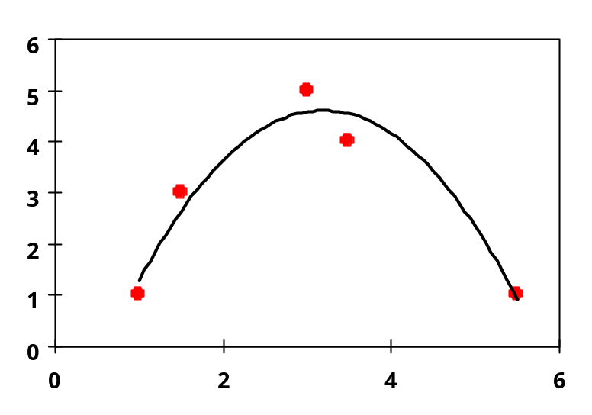
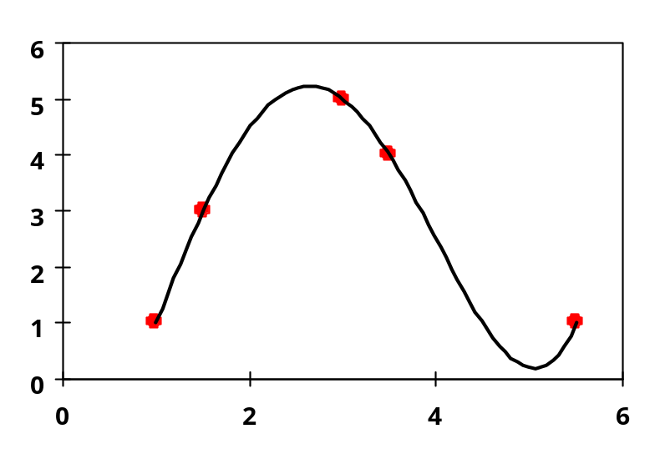
Model fitting:
expect some errors in data, emphasize on the model
Interpolation:
capture trend of confidently accurate data

Slide 5
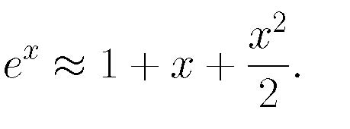
Sources of errors:
(1) Formulation error: assumption.
(2) Truncation error: numerical method, e.g.,
(3) Round-off error: finite-digit in computing.
(4) Measurement error: data collection.

Slide 6
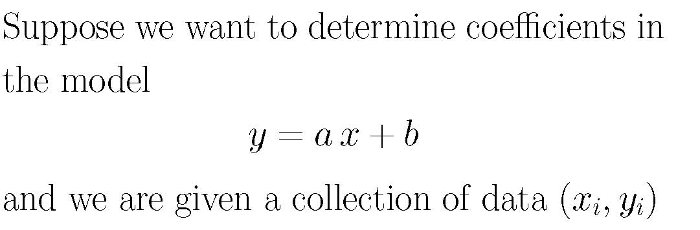
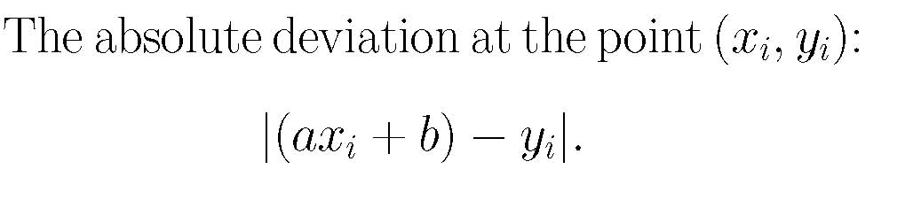
3.1. Fitting Models to Data Graphically
系数
偏差

Slide 7
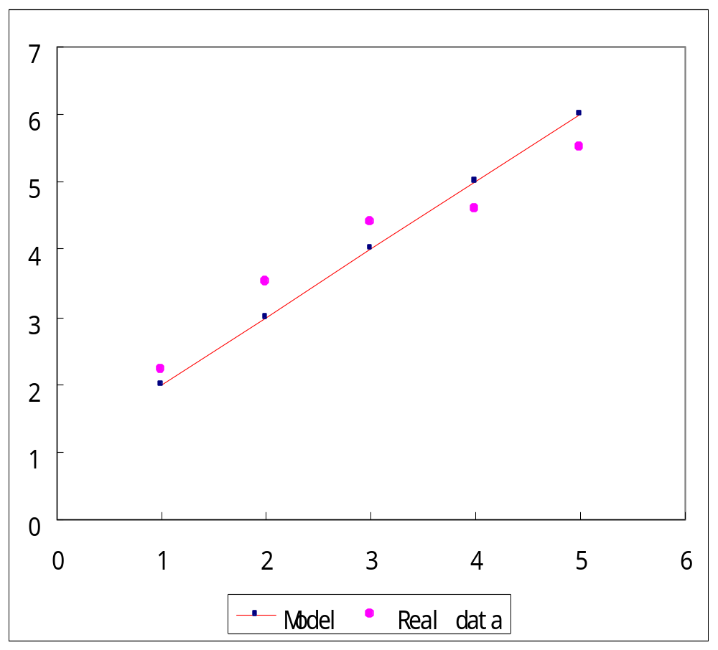
Visual Model Fitting with the Original Data
Absolute deviation

Slide 8
Strategies: To minimize
(a) the largest absolute deviation;
(b) the sum of absolute deviation; or
(c) The sum of squared deviations.

Slide 9
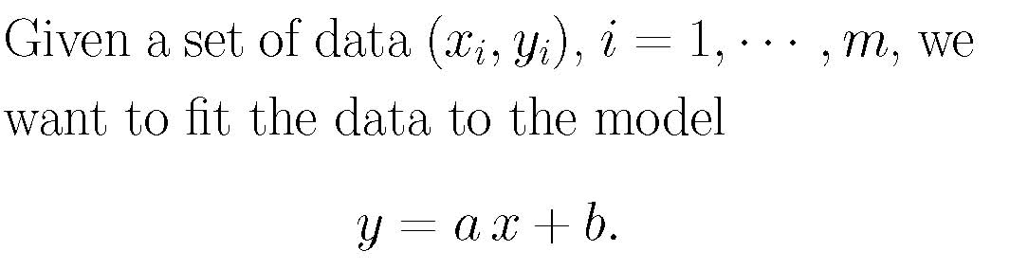
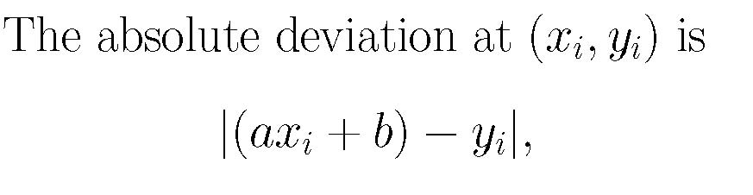
Analytic Methods of Model Fitting
Minimize the largest absolute deviation.
Chebyshev Approximation Criterion:

Slide 10
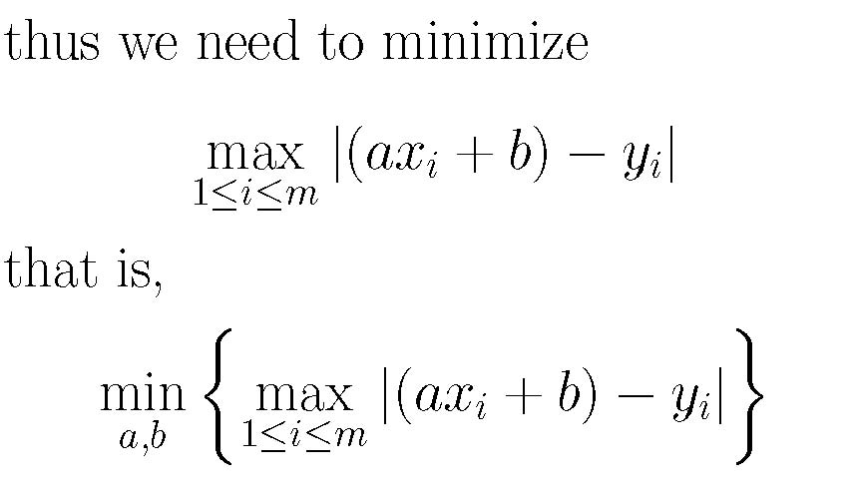

Slide 11
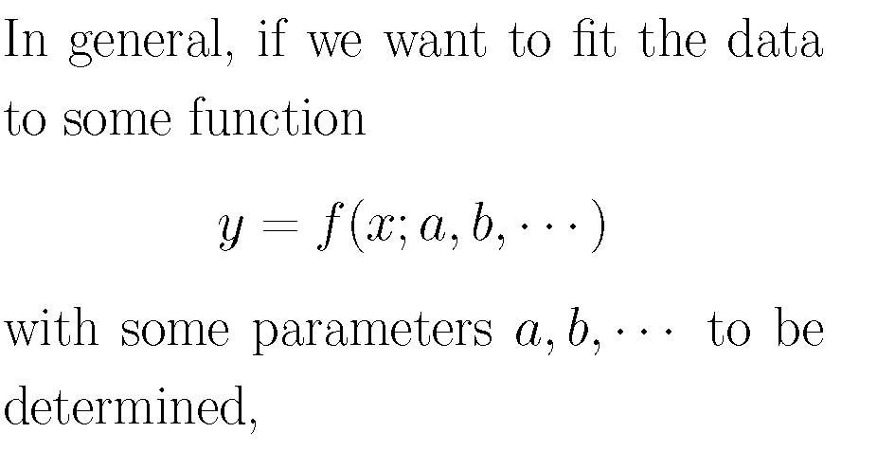
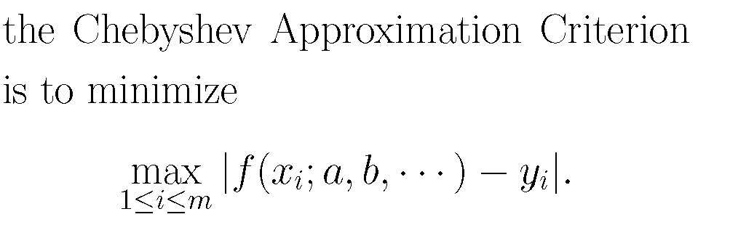
参数

Slide 12
Example (p. 115).
Suppose we measure the line segments AB, BC, and AC and get
AB=13, BC=7, AC=19.
How to determine the approximate lengths of AB, BC, and AC?
A
B
C

Slide 13
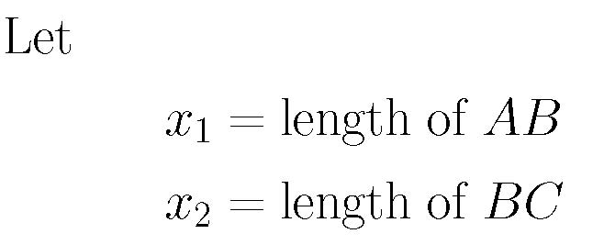
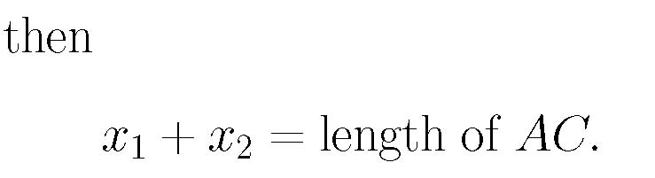

Slide 14
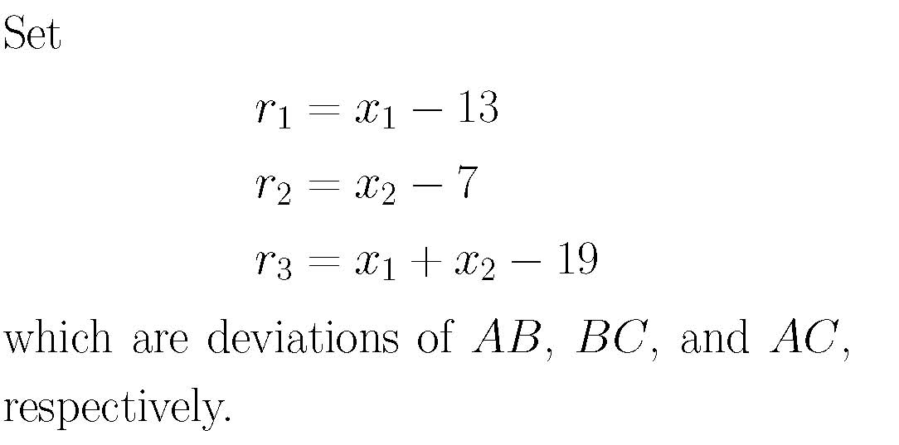
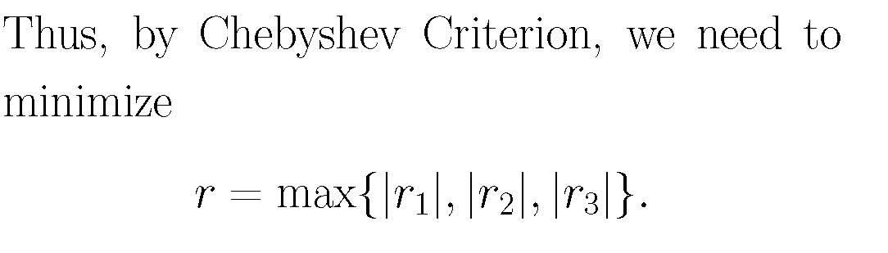

Slide 15
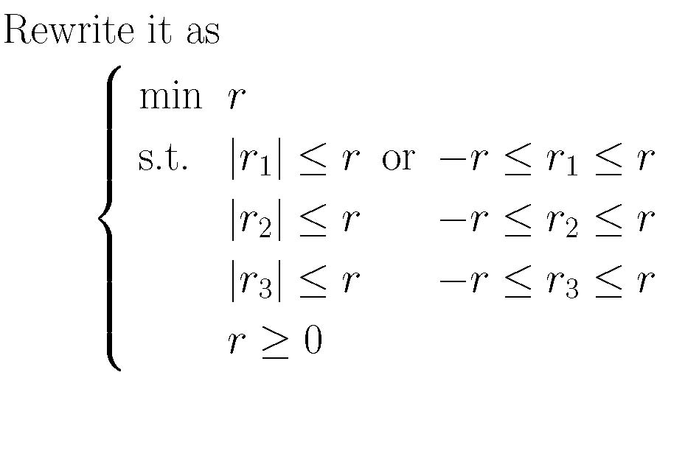

Slide 16
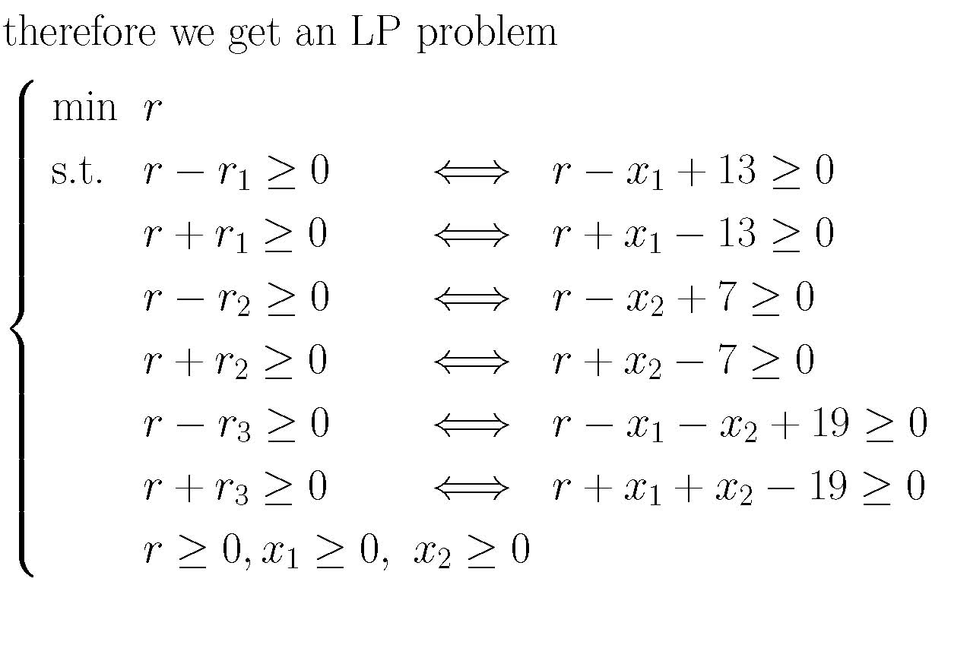
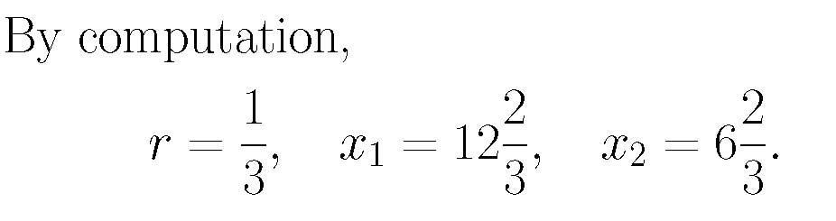
Linear Programming, 线性规划

Slide 17
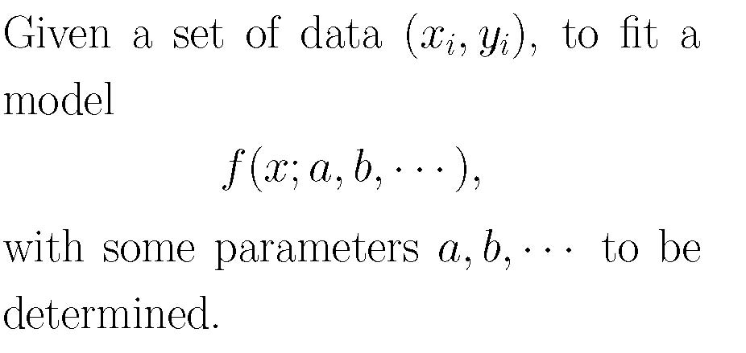
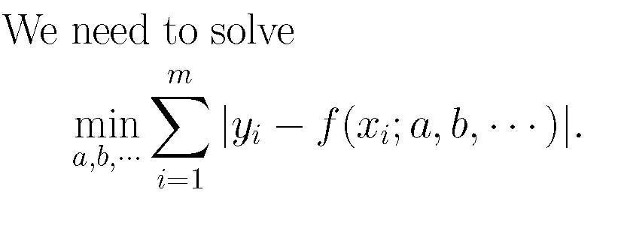
(2) Minimizing the sum of the absolute deviations:
This is hard to solve

Slide 18
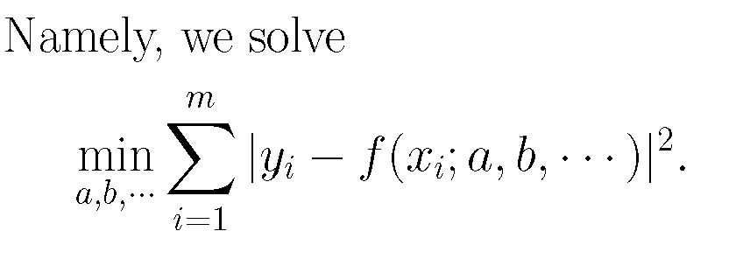
最小二乘
Least-Squares Criterion:
(3) Minimize the sum of the squares of deviations.
偏导数
This can be solved theoretically by setting all partial derivatives with respect to a, b,… equal to zero.

Slide 19
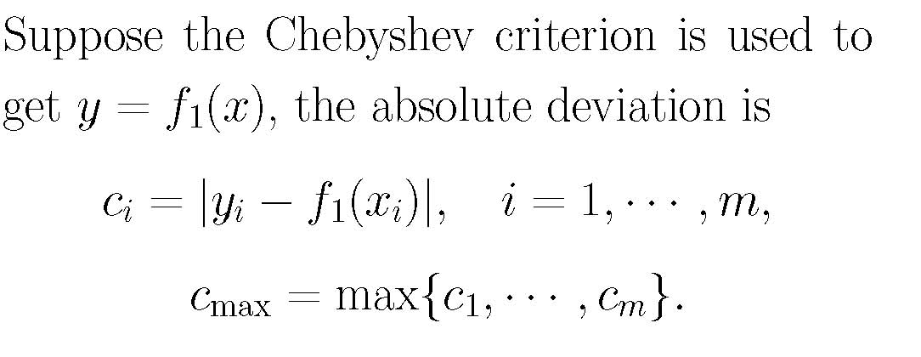
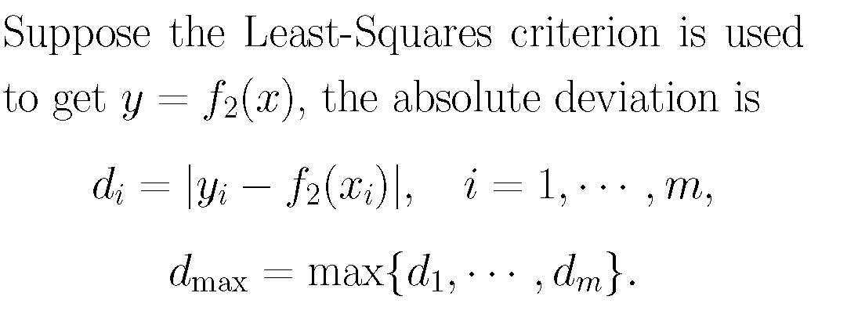

Slide 20
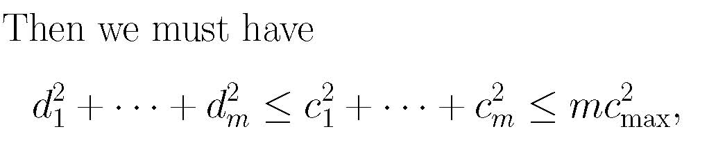
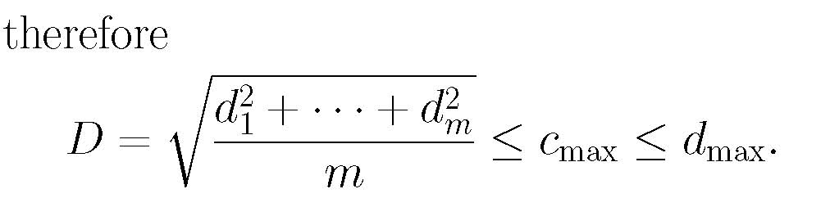

Slide 21
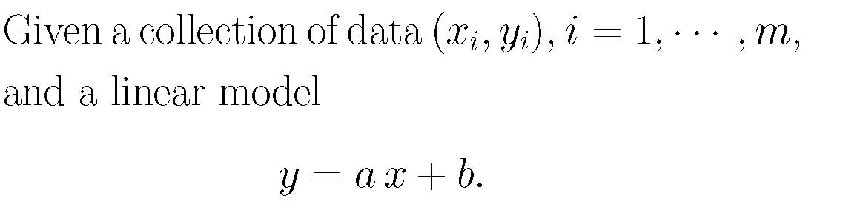
Applying the Least-Squares Criterion
Fitting a Straight Line

Slide 22
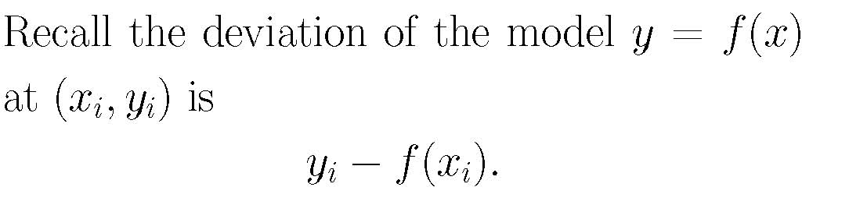
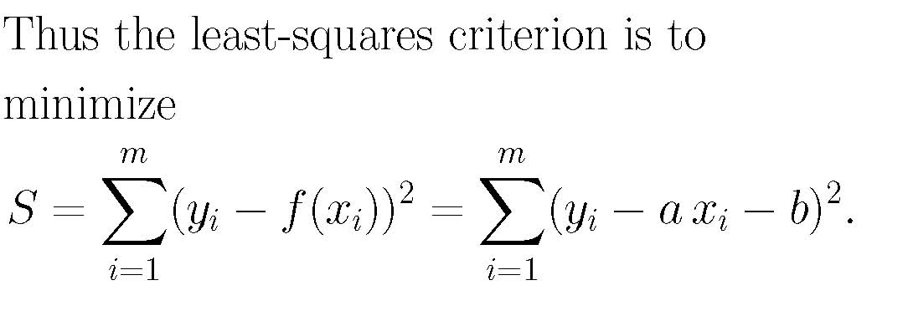

Slide 23
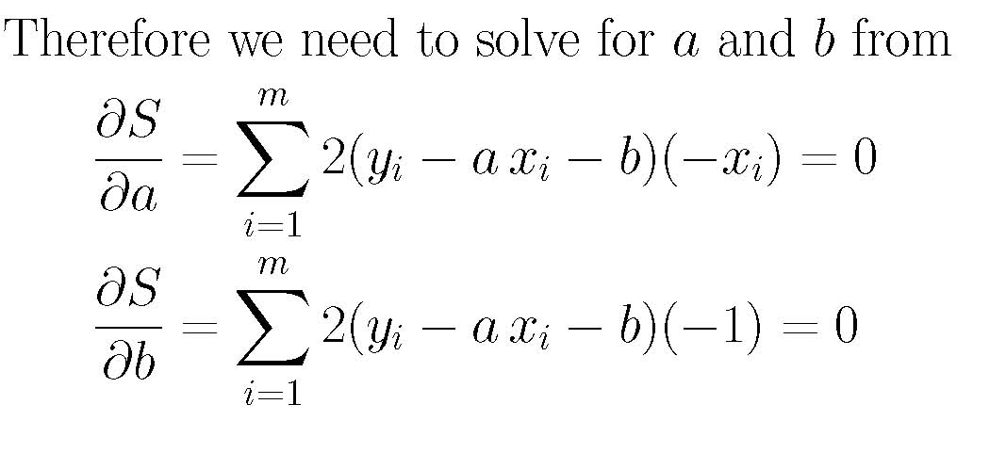
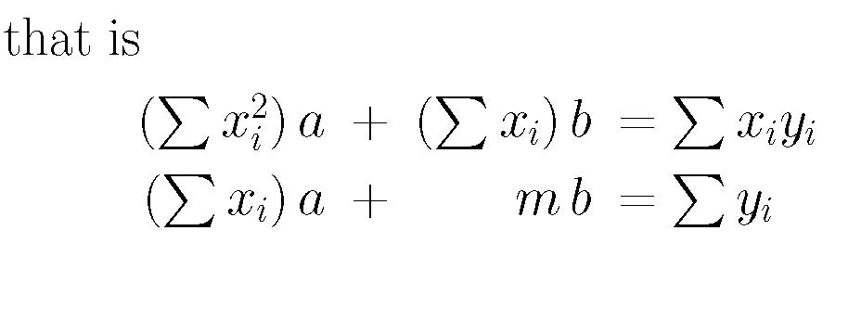

Slide 24
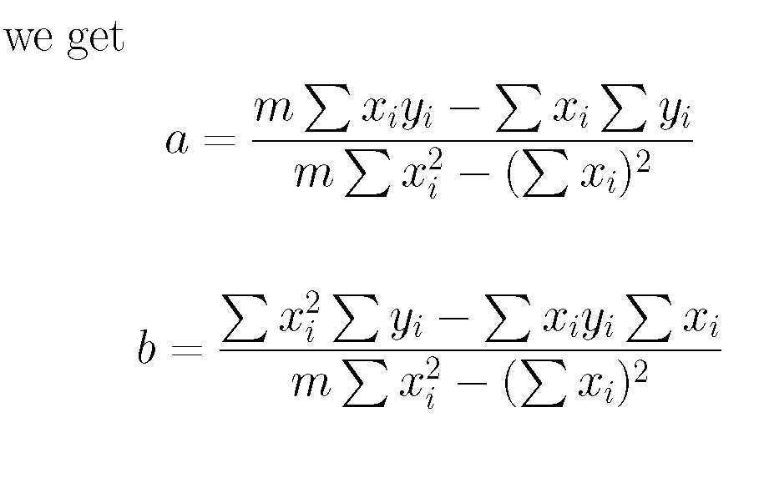
slope
intercept
Formula (3.5) and (3.6) of p. 122.

Slide 25
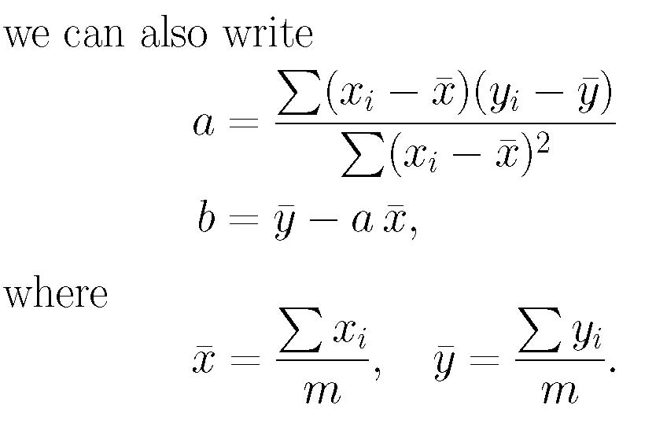
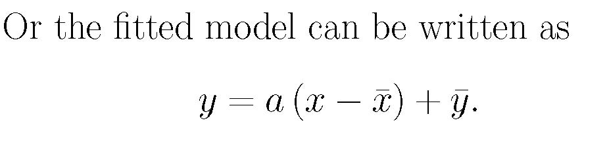

Slide 26


Fitting a Power Curve
Consider functions in the form
where n is fixed.
The least-squares estimate of the model requires some constant a that leads to the minimization of
which means that

Slide 27

Consider the data set from Table 3.3 (p. 123)
And fit them into the model

Slide 28


As n = 2, the least-square estimate of a is given by
Taking the values of x_{i} and y_{i} from Table 3.3, we compute a = 3.1869 (rounded to four decimal points), and thus the least-squares approximated model:

Slide 29
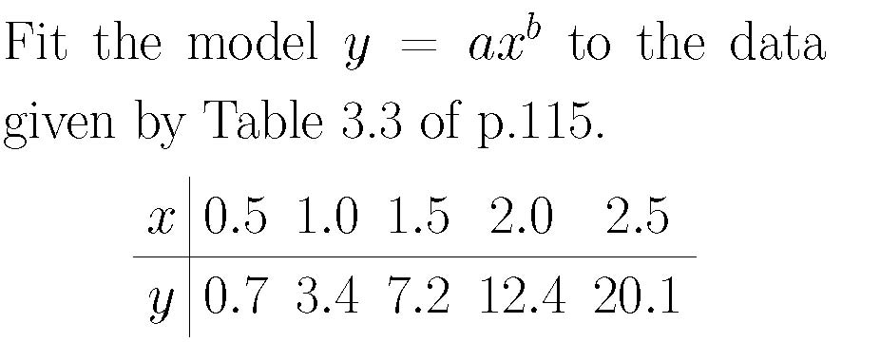
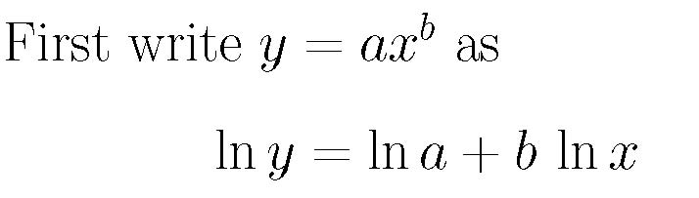
Transformed Least-Squares Fit
Example：

Slide 30
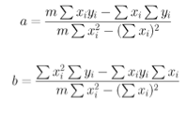
Remember, for fitting y = ax + b, we have

Slide 31
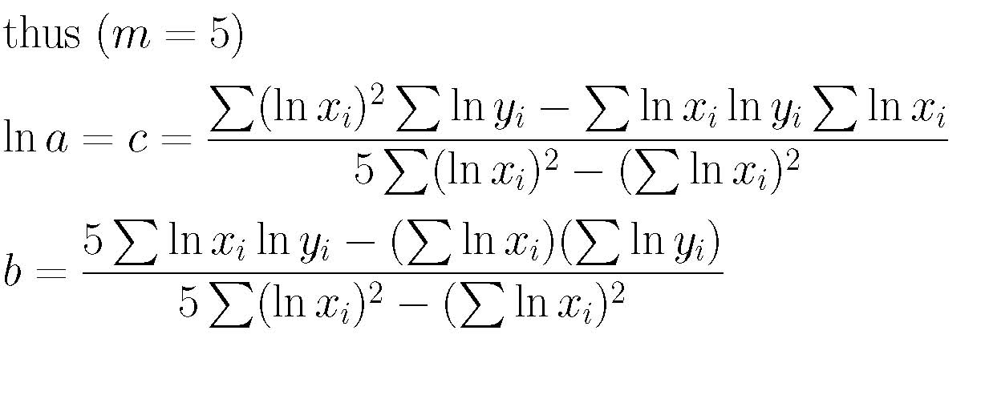
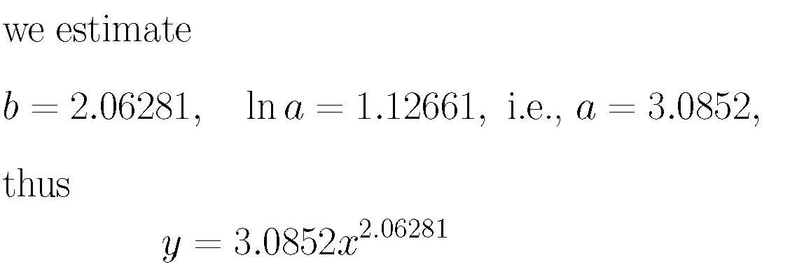

Slide 32
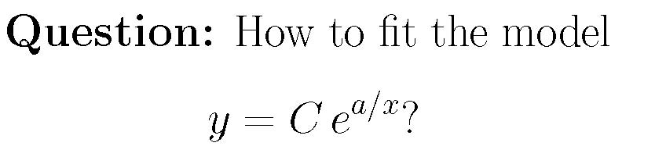
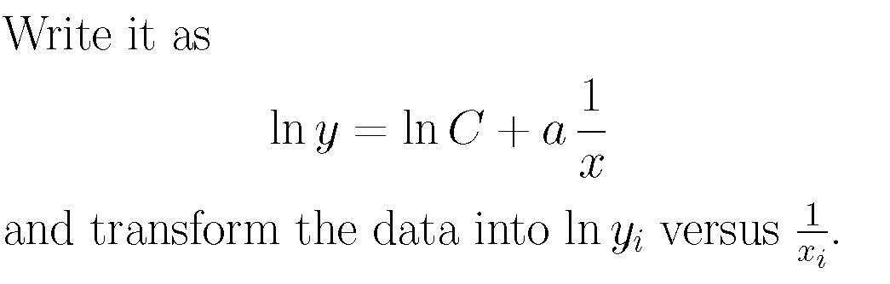

Slide 33
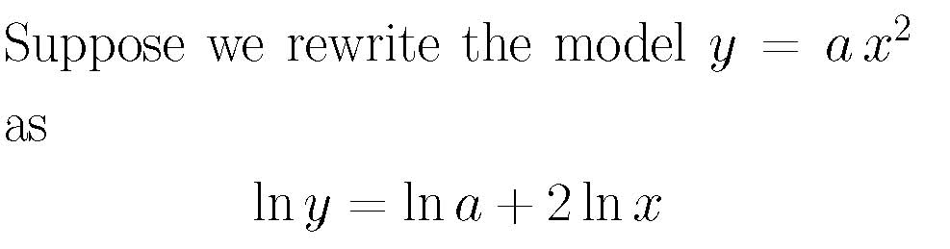
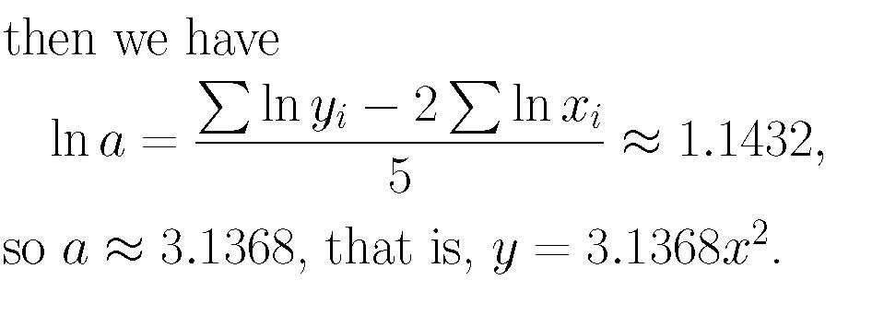
Warning: Transformation may change the model. Thus we do transformation only if it is necessary.

Slide 34
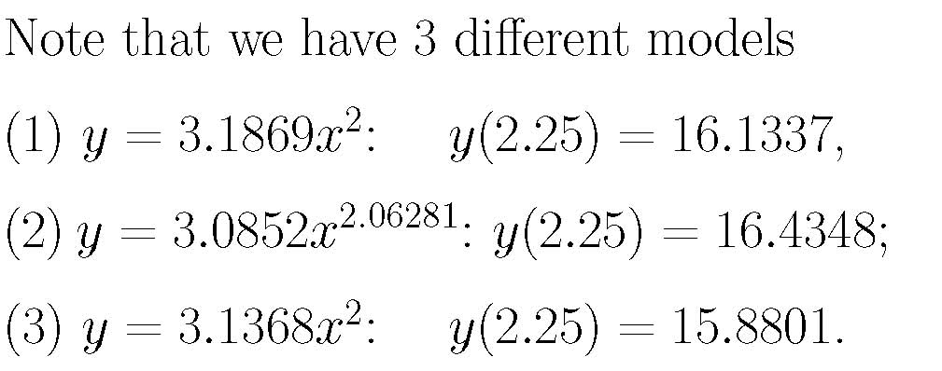
so the least-squares fit for transformed equation does not coincide with that for the original equation.
RULE: If an equation is difficult to differentiate but can be transformed to a linear equation, we can use the least-squares for linear equation to approximate.

